Slide 1
John Gensic
Dual Credit Biology Ivy Tech 101 (Biology II)
Penn High School

Slide 2
RET Module 2022
Overall Goal:explore and create interesting data representations to make and evaluate evidence based claims.

Slide 3
Module Progression
Lesson A: SWBAT: select a data set, then evaluate and make evidence based claims. (Shreya’s undergrads’ data representations)
Lesson B: SWBAT: make and defend a data representation for an experiment they create to test artificial intelligence. (GPT3 experiments)
Lesson C: SWBAT: evaluate carbon emission (and emission reduction) claims and evidence.
Lesson C Part 2: SWBAT: design an experiment related to efficiency and carbon emissions. Potential electric bike experiment.

Slide 4
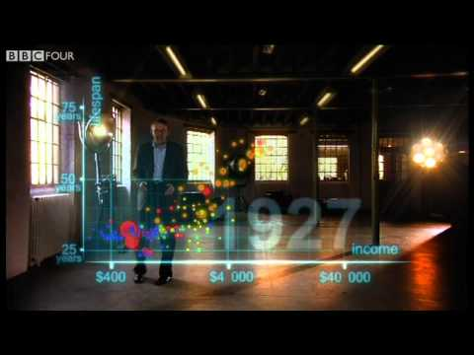
Lesson A: select a data set, then evaluate and make evidence based claims. Engage and Explore
Engage:
Watch:
Hans Rosling's 200 Countries, 200 Years, 4 Minutes - The Joy of Stats
https://www.youtube.com/watch?v=jbkSRLYSojo
Questions:
What was on the y-axis? X-axis?
HLPA: High, Low, Pattern, Anomaly for this data set?
Notes:
Bonus other video

Slide 5
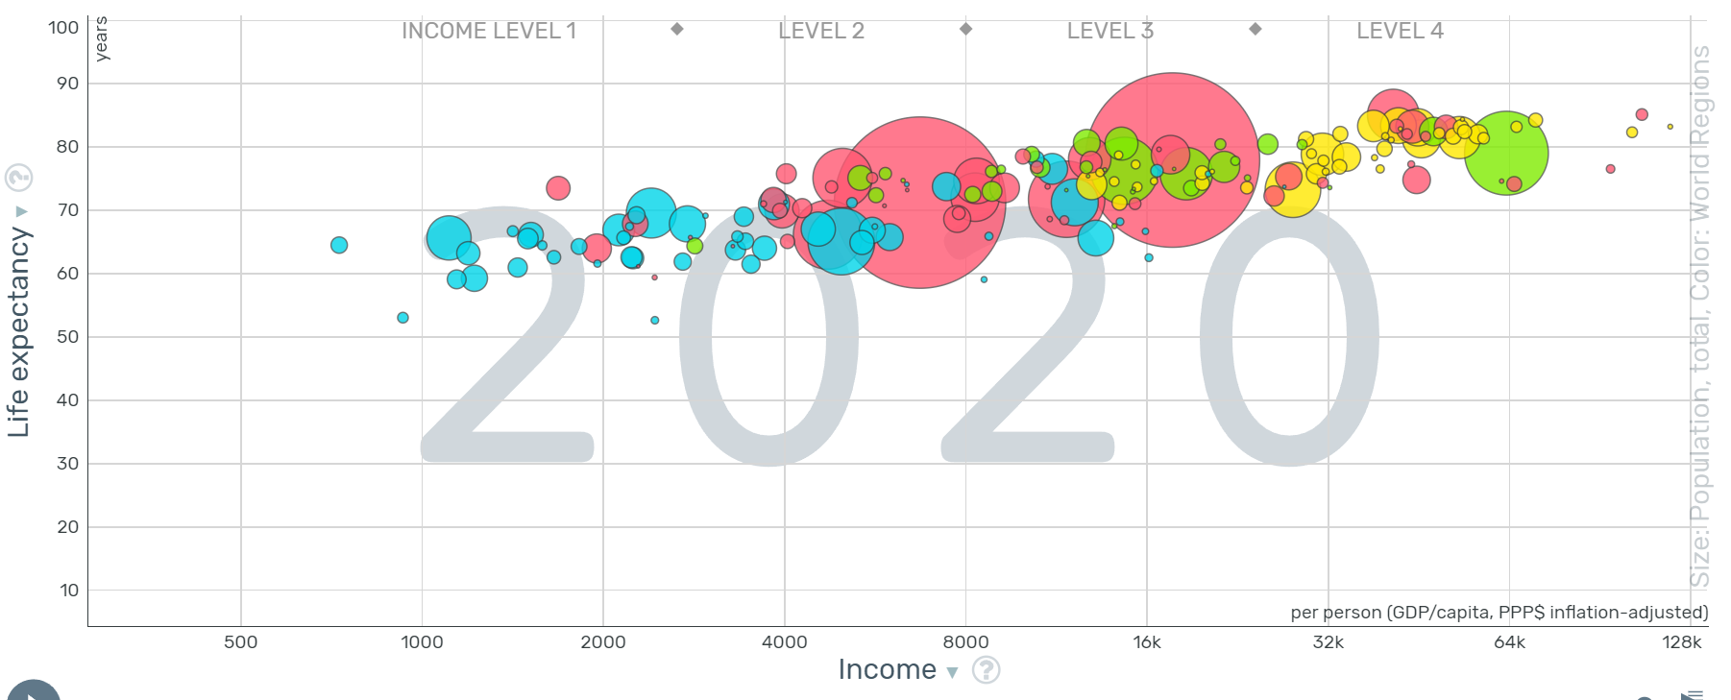
https://www.gapminder.org/tools/#$chart-type=bubbles&url=v1

Slide 6
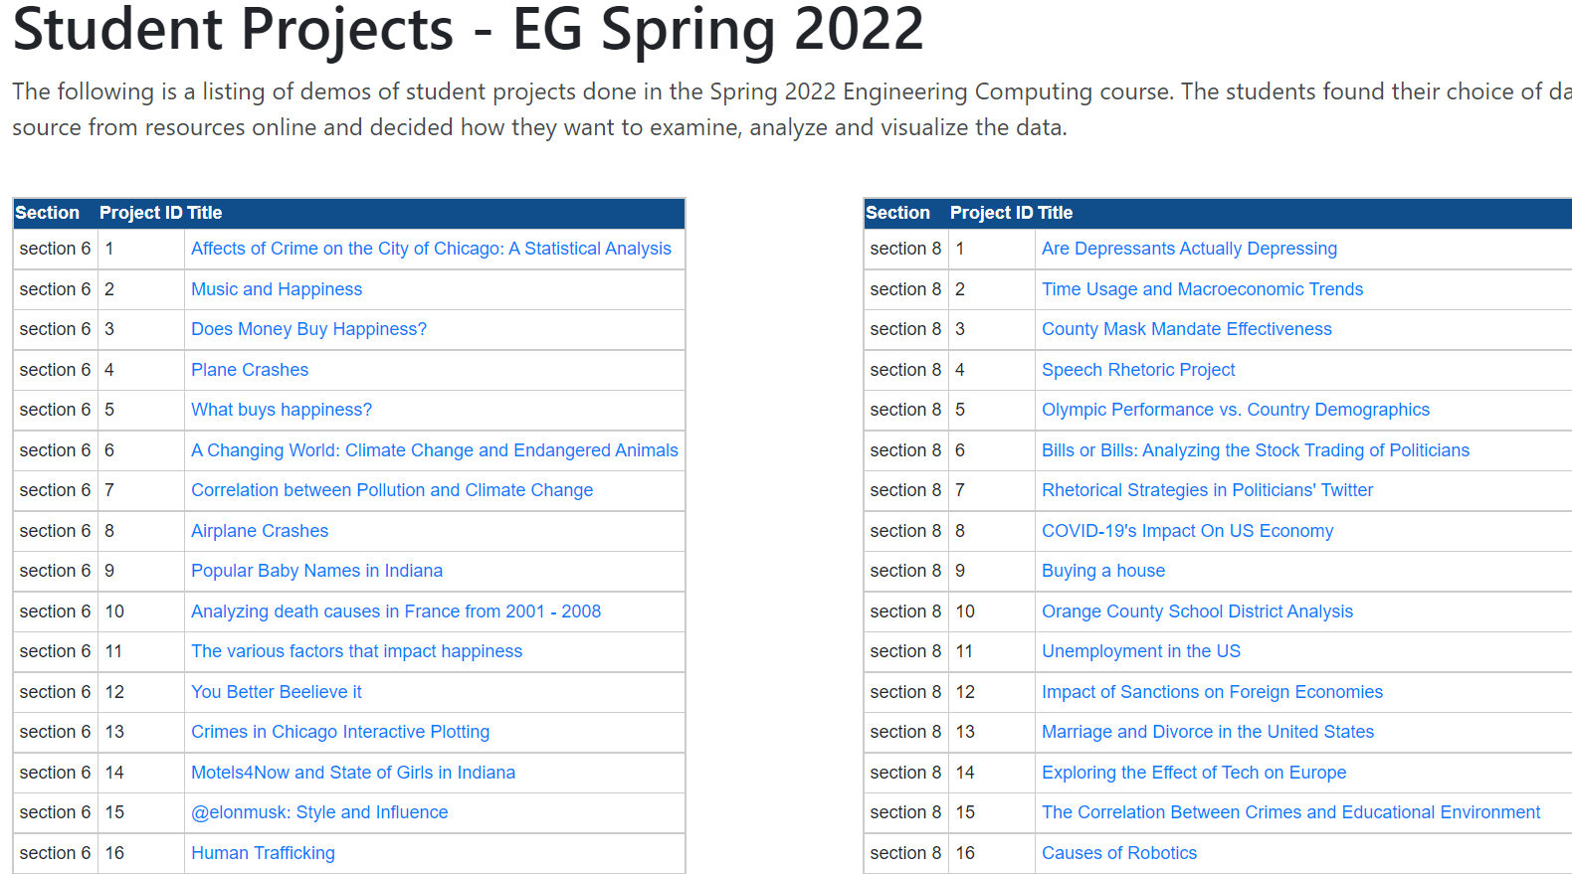
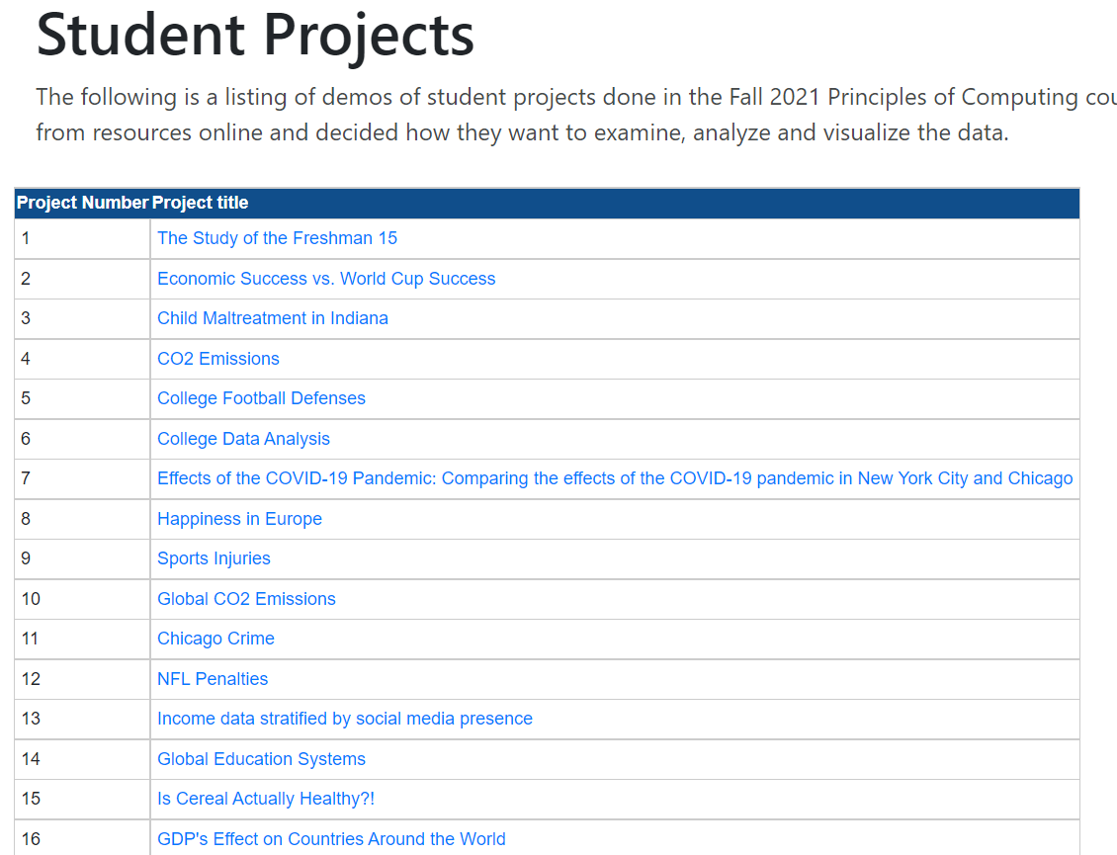
Lesson A: select a data set, then evaluate and make evidence based claims. Explore
Data Projects Engineering Computer Science projects
Data Projects Non-engineering Computer Science

Slide 7
Explore 3 different data sets that are interesting to you.
List those three interesting data sets
Consult with your teacher about which data set you want to dig into more deeply.
Proceed to the next slide to begin to explain and elaborate based on the data.

Slide 8
Lesson A: select a data set, explain and evaluate it to make evidence based claims.
Select three topics, talk with the teacher to get approval of the topic to dig deeper into.
What large topic is being explored?
What takeaways/claims were made?
Do you feel the website author had sufficient evidence to support those claims?
Which biological concepts does this more closely connect with? (resources? Ecology/ecosystems? Genetics? Behavior? Evolution?)
What patterns did you notice in the data?
Why do you think there were these patterns?
What stood out to you about this data/topic?
What additional data would be useful to make sense of this situation/topic?
How does this data impact your life? Future decisions?
How could this data be used to help elevate the dignity of humans and help people do better in the world?
Notes:
What large topic is being explored?
What takeaways/claims were made?
Do you feel the website author had sufficient evidence to support those claims?
Which biological concepts does this more closely connect with? (resources? Ecology/ecosystems? Genetics? Behavior? Evolution?)
What patterns did you notice in the data?
Why do you think there were these patterns?
What stood out to you about this data/topic?
What additional data would be useful to make sense of this situation/topic?
How does this data impact your life? Future decisions?
How could this data be used to help elevate the dignity of humans and help people do better in the world?

Slide 9
Topic:
Link to page:
Author’s Takeaways/Claims:
Sufficient evidence for claims?
High:
Low:
Pattern:
Anomaly:
Assessment of lesson one: Formative for the next couple of lessons
Explanation of those patterns:
Biological Concepts:
Additional data you want to know?
Impact of this date on your life?
How can this data elevate the dignity of humans?
Notes:
What large topic is being explored?
What takeaways/claims were made?
Do you feel the website author had sufficient evidence to support those claims?
Which biological concepts does this more closely connect with? (resources? Ecology/ecosystems? Genetics? Behavior? Evolution?)
What patterns did you notice in the data?
Why do you think there were these patterns?
What stood out to you about this data/topic?
What additional data would be useful to make sense of this situation/topic?
How does this data impact your life? Future decisions?
How could this data be used to help elevate the dignity of humans and help people do better in the world?

Slide 10
Topic:
Link to page:
Author’s Takeaways/Claims:
Sufficient evidence for claims?
High:
Low:
Pattern:
Anomaly:
Explanation of those patterns:
Biological Concepts related to topic:
Additional data you want to know?
Impact of this date on your life?
How can this data elevate the dignity of humans?
Notes:
What large topic is being explored?
What takeaways/claims were made?
Do you feel the website author had sufficient evidence to support those claims?
Which biological concepts does this more closely connect with? (resources? Ecology/ecosystems? Genetics? Behavior? Evolution?)
What patterns did you notice in the data?
Why do you think there were these patterns?
What stood out to you about this data/topic?
What additional data would be useful to make sense of this situation/topic?
How does this data impact your life? Future decisions?
How could this data be used to help elevate the dignity of humans and help people do better in the world?

Slide 11
Topic:
Link to page:
Author’s Takeaways/Claims:
Sufficient evidence for claims?
High:
Low:
Pattern:
Anomaly:
Explanation of those patterns:
Biological Concepts related to topic:
Additional data you want to know?
Impact of this date on your life?
How can this data elevate the dignity of humans?
Notes:
What large topic is being explored?
What takeaways/claims were made?
Do you feel the website author had sufficient evidence to support those claims?
Which biological concepts does this more closely connect with? (resources? Ecology/ecosystems? Genetics? Behavior? Evolution?)
What patterns did you notice in the data?
Why do you think there were these patterns?
What stood out to you about this data/topic?
What additional data would be useful to make sense of this situation/topic?
How does this data impact your life? Future decisions?
How could this data be used to help elevate the dignity of humans and help people do better in the world?

Slide 12
Lesson B: SWBAT: make and defend a data representation for an experiment they create to test artificial intelligence (regarding something biologically related).
Engage: Demonstration of GPT-3 https://beta.openai.com/playground
Reminder of productive talk moves
See, think, wonder

Slide 13
Demonstration and exploration
Type in questions like, “Who is John Gensic (teacher name)?”
Type in objective vs. subjective questions. Ensure students focus their investigations on objective questions.
Type in
Have students sign up for GPT-3 “Open AI”
Use about 7 minutes to “play around” with GPT-3 explore.

Slide 14
Explain: Example comparison questions/question types.
1
2
What do you notice about these two questions? As you think of questions to test GPT-3 with, how does the structure of these questions and responses impact your decision making?
Notes:
riefly describe GPT-3 with https://www.techtarget.com/searchenterpriseai/definition/GPT-3
Without computers, and using 2 by 3 white boards. Students work in groups (3-4) to plan out two questions to test the accuracy of GPT-3? They are planning two investigations. The first is a question/prompt that they are interested in that is NOT related to the content of the course. The second is a question/prompt that connects with the content of the course (biology in this case).
Possible biology questions: Consider why questions you know the answer to, or can look up and find reliably.Examples to show.

Slide 15
Explain: Example comparison questions/question types.
1
2
What do you notice about these two questions? As you think of questions to test GPT-3 with, how does the structure of these questions and responses impact your decision making?
Notes:
riefly describe GPT-3 with https://www.techtarget.com/searchenterpriseai/definition/GPT-3
Without computers, and using 2 by 3 white boards. Students work in groups (3-4) to plan out two questions to test the accuracy of GPT-3? They are planning two investigations. The first is a question/prompt that they are interested in that is NOT related to the content of the course. The second is a question/prompt that connects with the content of the course (biology in this case).
Possible biology questions: Consider why questions you know the answer to, or can look up and find reliably.Examples to show.

Slide 16
Explain: Example comparison questions/question types.
1
2
3
What do you notice about these three questions? As you think of questions to test GPT-3 with, how does the structure of these questions and responses impact your decision making?
Notes:
riefly describe GPT-3 with https://www.techtarget.com/searchenterpriseai/definition/GPT-3
Without computers, and using 2 by 3 white boards. Students work in groups (3-4) to plan out two questions to test the accuracy of GPT-3? They are planning two investigations. The first is a question/prompt that they are interested in that is NOT related to the content of the course. The second is a question/prompt that connects with the content of the course (biology in this case).
Possible biology questions: Consider why questions you know the answer to, or can look up and find reliably.Examples to show.

Slide 17
Determine your two questions
Using a 2 ft. by 3 ft. whiteboard working in groups of 3-4, devise two questions you will be testing GPT-3 with.
Question 1 to ask GPT-3: (not biology related, but you think will challenge GPT-3)
Hypothesis of GPT-3 potential responses:
Data Table to collect responses:
How might you convert your responses into a data representation? (compare the responses within questions? Across questions? Lengths? Words over 4 letters? Show a couple correct and incorrect?)
Question 2 to ask GPT-3: (biology related):
Hypothesis of GPT-3 potential responses:
Data Table to collect responses:
How might you convert your responses into a data representation? (compare the responses within questions? Across questions? Lengths? Words over 4 letters? Show a couple correct and incorrect?)

Slide 18
Homework/Extension/Start of Next Class:
Homework: Read https://www.scientificamerican.com/article/we-asked-gpt-3-to-write-an-academic-paper-about-itself-then-we-tried-to-get-it-published/
Extension: Robots Enact Malignant Stereotypes https://dl.acm.org/doi/pdf/10.1145/3531146.3533138
Next class: time to prepare data representation on google sheets or using another medium to communicate the data/results (think about bar graphs, High, Low, Pattern, Anomaly + other options from the first lesson).

Slide 19
Lesson C: better understand efficiency by evaluating carbon emission (and emission reduction) claims and evidence. (Potential electric bike experiment)
Engage: Keeling curve/data cherry picking of just 6 summer months vs. two years
Explore: Carbon footprint
Explain: Climate change video
Elaborate: Evaluations of specific claim
Extension: Presentation of carbon emission reduction plan

Slide 20
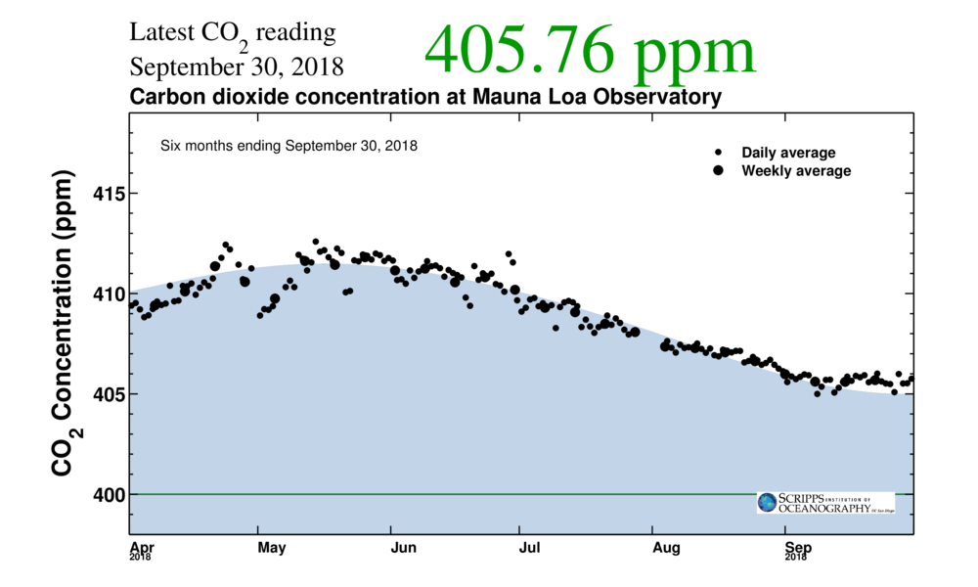

Slide 21
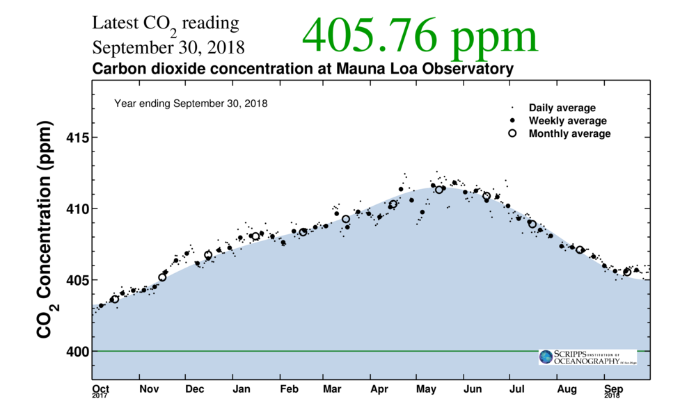

Slide 22
Engage: Prediction/Estimation
Estimate the amount of greenhouse gases you are responsible for in one year.
1 lbs of CO₂e
10 lbs of CO₂e
100 lbs CO₂e
1,000 lbs CO₂e
10,000 lbs CO₂e
100,000 lbs CO₂e
1,000,000 lbs CO₂e
10,000,000 lbs CO₂e
How many tree equivalents are you responsible for each year?
1 trees
10 trees
100 trees
1,000 trees
10,000 trees
100,000 trees
1,000,000 trees
10,000,000 trees

Slide 23
Explore
Go to and attempt to complete https://www3.epa.gov/carbon-footprint-calculator/
Homework: text the questions you don’t know the answer to to the people in your life that may know.
Before leaving today: Select the carbon emissions you want to dig more deeply into…
Notes:
Home Based Carbon Calculator
https://coolclimate.berkeley.edu/calculator
Business Based Carbon Calculator
https://coolclimate.berkeley.edu/business-calculator

Slide 24
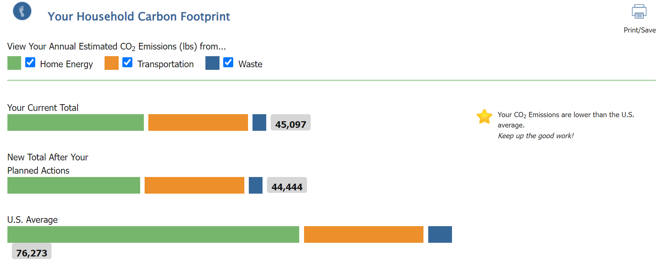

Slide 25
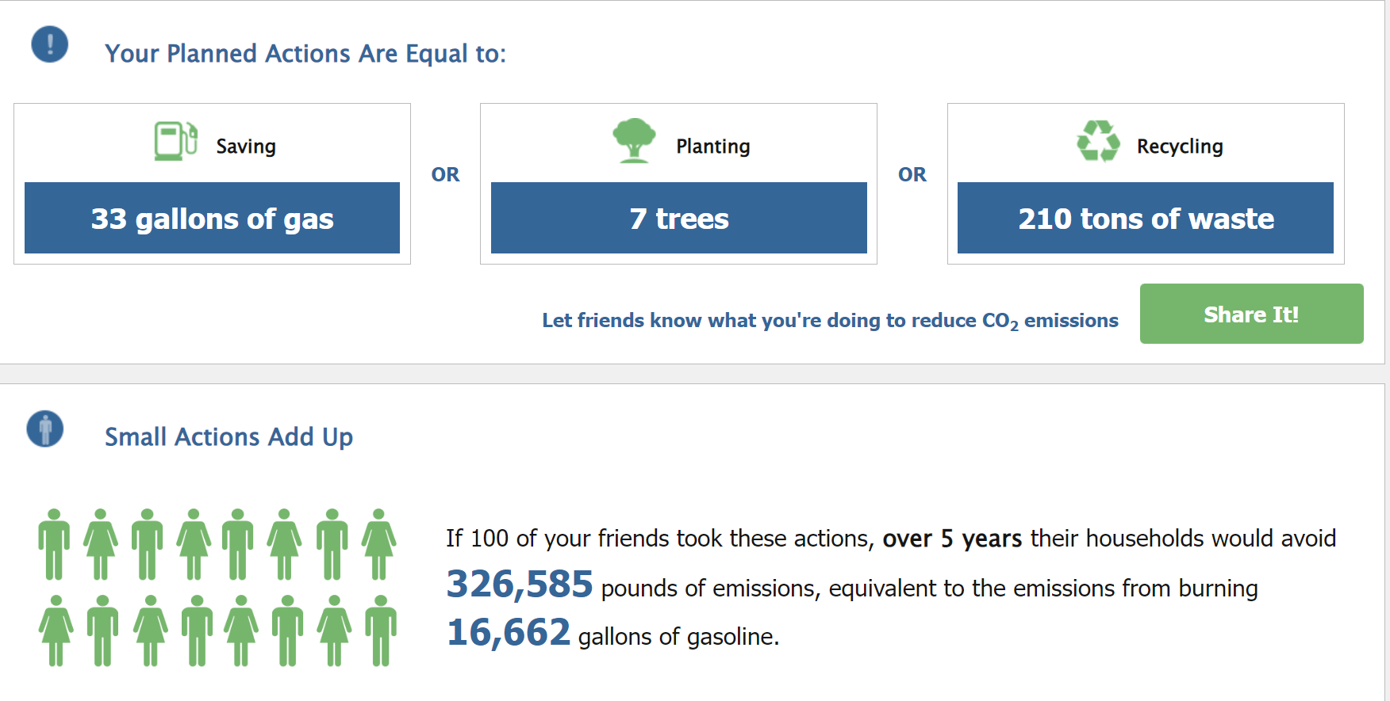

Slide 26
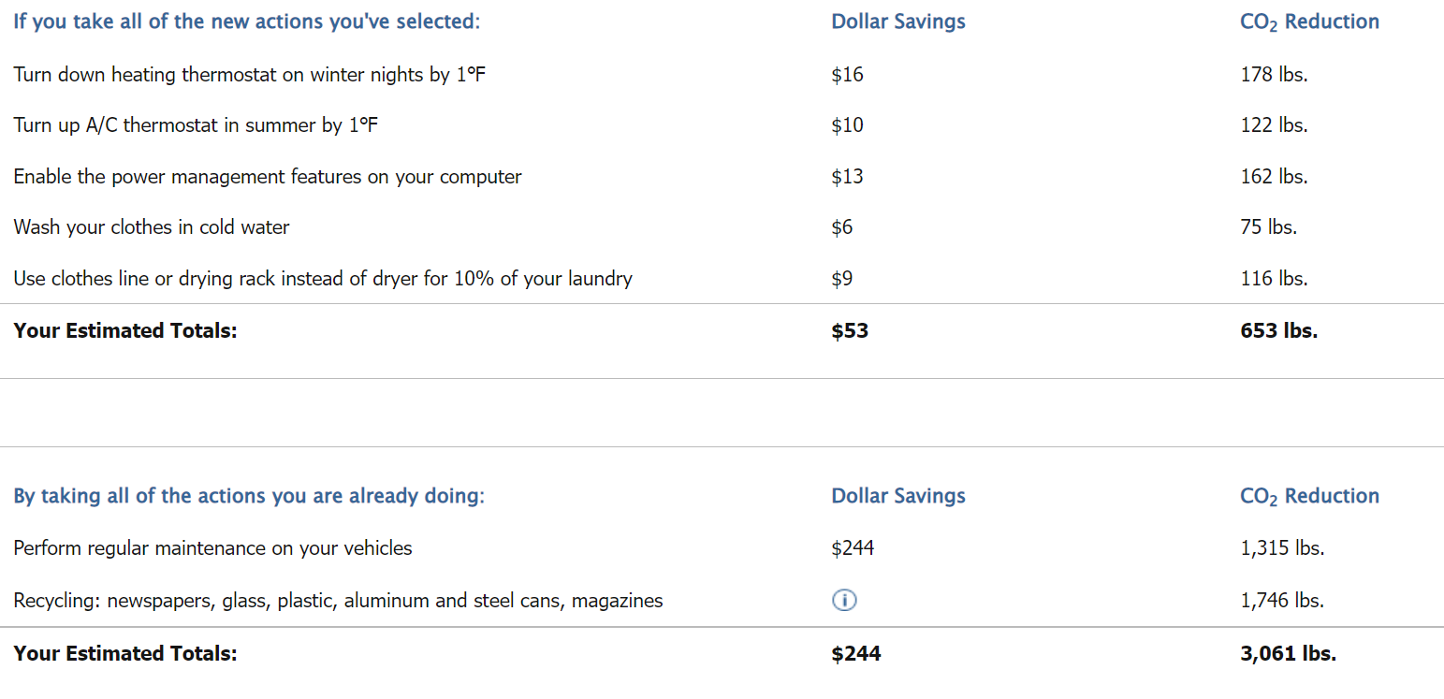

Slide 27
Digging deeper into carbon emissions for two specific item/activity
250 g of cheese
125 g of hamburger
A takeout taco
1 kg of rice
1 kg of tomatoes
8 oz. steak
Pair of shoes
Pair of pants
Rush-hour drive to work
Bag of cement
Leaving the lights on
Night in a hotel
A leg of lamb
A week of food
Using a smartfood
New carpet
A necklace
Christmas waster/excess
Insulating an attic
Funeral
A computer
A pet
A mortgage
A medical operation
Solar panels
Flying from LA to Spain
A new car
A person
Space Tourism
A wind turbine
A car crash
Having a kid
Building a new home
The World Cup
A new coal mine
Cryptocurrencies
The USA
All the world’s data centers
Wildfires
A war
deforestation
8 oz. of strawberries
A roll of toilet paper
A bowl of oatmeal
A letter in the mail
Traveling a mile by train
Ice cream
A latte
1 kg of trash in the landfill
A loaf of bread
A pint of beer
Taking a bath
Spending $1
10 in pizza
200 g of fish
16 oz. of milk
8 oz. of asparagus
Bottle of wine
Bunch of flowers
Dozen eggs
A day’s protein
Desalinating 1000 liters of water
Sending a text only message
Sending a text with a pic
Sending a group text
Sending a text with a pic to a group
An email
Plastic grocery bag/paper grocery bag
Riding to school on a bus
Driving to school in a civic, suv, electric car
Riding a bike to school
Riding an electric bike to school
An apple
A zoom call
Ironing a shirt
Boiling a liter of water
Boiled potatoes
An orange
A diaper
A shower
Hour of watching TV
Walking through an exterior door

Slide 28
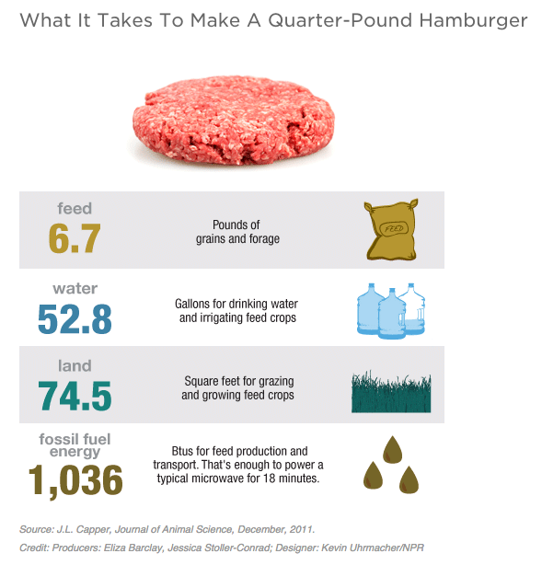
Elaborate: Digging deeper into carbon emissions claims
Students will select two items/actions find the carbon footprint online, create a slide with the following…
Comparison of Range of CO₂ estimate.
Comparison of Assumptions (what is not included).
Suggestions to reduce footprint.
Images of all of the sources of variation.
Sources and commentary on reliability of the source.

Slide 29
CO₂e emissions of vs.
1. Comparison of range of CO₂ estimate.
2. Assumptions (what is/is not included in this estimate).
3. Suggestions to reduce footprint. How could you use social influence.
4. Images of all of the sources of variation.
5. Sources and commentary on reliability of the source.
Notes:
Comparison of Range of CO₂ estimate.
Comparison of Assumptions (what is not included).
Suggestions to reduce footprint.
Images of all of the sources of variation.
Sources and commentary on reliability of the source.

Slide 30
Evaluate: How can we measure the efficiency of different forms of movement?
Experimental design, completion, and evaluation.
Option A: Comparing idling vehicles with a vernier CO₂ sensor.
Choices Electric Bike, 2004 Honda Civic, 2020 Plug in Hybrid Chrysler Van, Toyota Prius, Truck
Option B: Comparing traveling a set distance while measuring exhalation:
Walking, biking, running, electric biking, driving a car, by measuring breath counts or thermal energy of a bike.
Option C: Comparing heat generated after driving around a loop of the HS parking lot using a thermal camera.
Choices Electric Bike, 2004, Honda Civic, 2020 Plug in Hybrid, Toyota Prius Idle, Some pick up truck
Option D: Other idea?

Slide 31
Big Question: How can we measure the efficiency of different forms of movement?
Narrower Question: ________________________________________________________________________
_________________________________________________________________________________________
Indep. Variable:
Data Collection Tool:
Control:
Dep. Variable:
Constants:
Procedure:
Data Table/Collection:

Slide 32
Efficiency Expenditures
Electric Bike Conversion Kit + Battery
https://bafangusadirect.com/products/complete-bafang-750w-bbs02-mid-drive-ebike-motor-kit-battery?variant=39431595393223&gclid=Cj0KCQjw_7KXBhCoARIsAPdPTfivg1XWj4wf24Tk8WiqJ9kY9R6YVmm6bevS8mOCCW7mWL_E9sk0X9MaAqkfEALw_wcB Starting at $799.00
Maybe: https://www.vernier.com/product/solar-energy-exploration-kit/

